Slide 1
Operating Systems
System Structures

Slide 2
References
Operating System Concepts, 7th and 8th editions, Silberschatz et al. Wiley.
Modern Operating Systems, Andrew S. Tanenbaum, 3rd edition, 2009.

Slide 3
Outline
Operating System Services
User Operating System Interface
System Calls
System Programs
Operating System Structure

Slide 4
Objectives
To describe the services an operating system provides to users, processes, and other systems
To discuss the various ways of structuring an operating system

Slide 5
Operating System Services
Two major tasks of an operating system
  Providing a nice/convenient environment for users/applications
    Provide some set of services for user applications
    Visible to users
  Resource allocation and management
    Not much visible to users

Slide 6

OS Services

Slide 7
Operating System Services
1) One set of operating-system services provides functions that are helpful to the user:
  User interface - Almost all operating systems have a user interface (UI)
    Varies between Graphics User Interface (GUI), Command-Line (CLI), Batch Processing
  Program execution - The system must be able to load a program into memory and run that program, end execution either normally or abnormally (indicating error)
  I/O operations - A running program may require I/O, which may involve a file or an I/O device
  File-system manipulation - Programs need to read and write files and directories, create and delete them, search them, list file Information, permission management.

Slide 8
Operating System Services
  Communications – Processes may exchange information, on the same computer or between computers over a network
    Communications may be via shared memory or through message passing (packets moved by the OS)
  Error detection and handling – OS needs to be constantly aware of possible errors
    May occur in the CPU and memory hardware, in I/O devices, in user program
    For each type of error, OS should take the appropriate action to ensure correct and consistent computing

Slide 9
A View of Operating System Services
2) Another set of OS functions exists for ensuring the efficient operation of the system itself via resource sharing
  Resource allocation - When multiple users or multiple jobs running concurrently, resources must be allocated to each of them
    Many types of resources - CPU, Memory, File Storage, I/O devices, etc.
  Accounting - To keep track of which users use how much and what kinds of computer resources
  Protection and Security - The owners of information should be able to control use of that information; concurrent processes should not interfere with each other
    Access control to resources, authentication, …

Slide 10
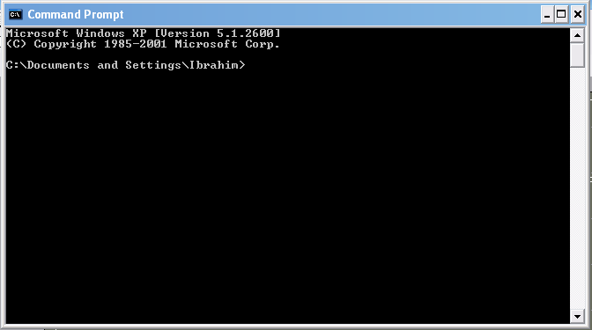
[User - Operating System] Interface - CLI
Command Line Interface (CLI) or command interpreter allows direct command entry
  Sometimes implemented in kernel, sometimes by systems program
  Sometimes multiple flavors implemented – shells
  Primarily fetches a command from user and executes it
    Sometimes commands built-in, sometimes just names of programs
      later case: add new programs easily

Slide 11
[User-Operating System] Interface - GUI
User-friendly desktop metaphor interface
  Icons represent files, programs, actions, etc
  Various mouse buttons over objects in the interface cause various actions (provide information, options, execute function, open directory
Many operating systems now include both CLI and GUI interfaces
  Linux: command shells available (CLI); KDE as GUI

Slide 12
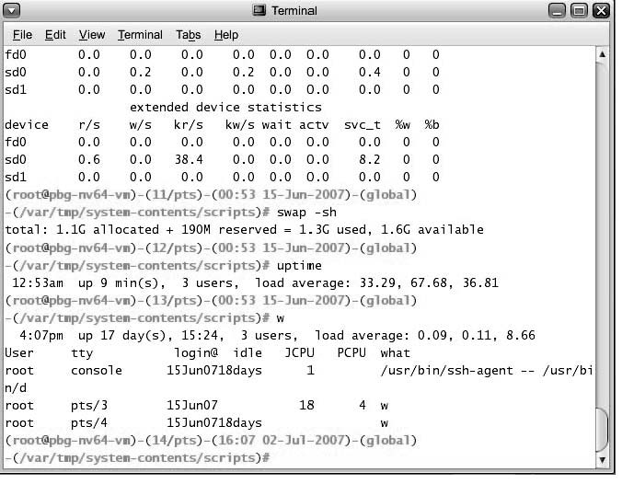
Bourne Shell Command Interpreter

Slide 13

The MacOS X GUI

Slide 14
System Calls
Programming interface to the services provided by the OS
  Interface provided to applications
Typically written in a high-level language (C or C++)
Example to illustrate how system calls are used
“Writing a simple program to read data from one file and copy to another file”

Slide 15

System Calls: An Example
System call sequence to copy the contents of one file to another file

Slide 16
System Calls
Application
(a process, a
running program)
Application
Sytsem Call Interface
….
System Calls
(OS functions)
Each has a name/number, set of parameters
Other kernel functions
Kernel/OS
other kernel functions can be called by system calls

Slide 17
System Calls
Mostly accessed by programs via a high-level Application Program Interface (API) rather than direct system call use
Three most common APIs are :
  Win32 API for Windows,
  POSIX API for POSIX-based systems (including virtually all versions of UNIX, Linux, and Mac OS X),
  Java API for the Java virtual machine (JVM)
Win32 API function CreateProcess() calls the NTCreateProcess () system call defined in the Windows kernel
Why use APIs rather than system calls?

Slide 18
System Calls
Your Program
…
fd =open(…);
….
Your Program Code
user level code
API
open (…)
{…}
fopen(…)
{…}
Standard C library
Code
System Calls
sys_open (…)
{…}
Kernel Code
kernel level code

Slide 19

Example of Standard API
Consider the ReadFile() function in the
Win32 API—a function for reading from a file
A description of the parameters passed to ReadFile()
  HANDLE file—the file to be read
  LPVOID buffer—a buffer where the data will be read into and written from
  DWORD bytesToRead—the number of bytes to be read into the buffer
  LPDWORD bytesRead—the number of bytes read during the last read
  LPOVERLAPPED ovl—indicates if overlapped I/O is being used

Slide 20
System Call Implementation
Typically, a number associated with each system call
  System-call interface maintains a table indexed according to these numbers
The system call interface invokes intended system call in OS kernel and returns status of the system call and any return values
The caller need know nothing about how the system call is implemented
  Just needs to obey API and understand what OS will do as a result call
  Most details of OS interface hidden from programmer by API
    Managed by run-time support library (set of functions built into libraries included with compiler)

Slide 21

API – System Call – OS Relationship

Slide 22

Standard C Library Example
C program invoking printf() library call, which calls write() system call

Slide 23
System Call Parameter Passing
Often, more information is required than the identity of the desired system call
  Exact type and amount of information vary according to OS and call
Three general methods used to pass parameters to the OS
  1) Simplest: pass the parameters in registers
    In some cases, may be more parameters than registers
  2) Parameters stored in a block, or table, in memory, and address of block passed as a parameter in a register
  3) Parameters placed, or pushed, onto the stack by the program and popped off the stack by the operating system
  Last two methods do not limit the number or length of parameters being passed

Slide 24

Parameter Passing via Table

Slide 25
Types of System Calls
Process control
File management
Device management
Information maintenance
Communications
Protection

Slide 26

Examples of Windows and Unix System Calls

Slide 27
System Programs
System programs provide a convenient environment for program development and execution. They can be divided into:
  File manipulation (create, delete, copy, rename, print, list, …)
  Status information (date, time, amount of available memory, disk space, who is logged on, …)
  File modification (text editors, grep, …)
  Programming language support (compiler, debuggers, …)
  Program loading and execution (loaders, linkers)
  Communications (ftp, browsers, ssh, …)
  Other System Utilities/Applications may come with OS CD (games, math solvers, plotting tools, database systems, spreadsheets, word processors, …)

Slide 28
System Programs
Users’ view of the operating system is defined by system programs, not the actual system calls
System programs provide a convenient environment for program development and execution
  Some of them are simply user interfaces to system calls; others are considerably more complex
    create file: simple system program that can just call “create” system call or something similar
    compiler: complex system program

Slide 29
System Programs
Users
System Programs
Other User Applications
System Calls
Kernel
From OS’s view: system+user programs are all applications

Slide 30
User
User Interface (GUI/CLI)
System Programs
Application Programs
System Calls
Rest of Kernel

Slide 31
OS Structure
Simple Structure (MSDOS)
Layered Approach
Microkernel Approach
Modules Approach

Slide 32

Simple Structure
MS-DOS – written to provide the most functionality in the least space
  Not divided into modules
  Although MS-DOS has some structure, its interfaces and levels of functionality are not well separated

Slide 33
Layered Approach
The operating system is divided into a number of layers (levels), each built on top of lower layers. The bottom layer (layer 0), is the hardware; the highest (layer N) is the user interface.
With modularity, layers are selected such that each uses functions (operations) and services of only lower-level layers

Slide 34
Unix
UNIX – limited by hardware functionality, the original UNIX operating system had limited structuring. The UNIX OS consists of two separable parts
  Systems programs
  The kernel
    Consists of everything below the system-call interface and above the physical hardware
    Provides the file system, CPU scheduling, memory management, and other operating-system functions; a large number of functions for one level

Slide 35

Traditional UNIX System Structure

Slide 36

Layered Operating System

Slide 37
Microkernel System Structure
Moves as much from the kernel into “user” space
Communication takes place between user modules using message passing
Benefits:
  Easier to extend a microkernel
  Easier to port the operating system to new architectures
  More reliable (less code is running in kernel mode)
  More secure
Detriments:
  Performance overhead of user space to kernel space communication

Slide 38
Modules
Most modern operating systems implement kernel modules
  Uses object-oriented approach
  Each core component is separate
  Each talks to the others over known interfaces
  Each is loadable as needed within the kernel
Overall, similar to layers but with more flexible

Slide 39

Solaris Modular Approach

Slide 40
Virtual Machines
Hardware is abstracted into several different execution environments
  Virtual machines
Each virtual machine provides an interface that is identical to the bare hardware
A guest process/kernel can run on top of a virtual machine.
  We can run several operating systems on the same host.
  Each virtual machine will run another operating system.

Slide 41
Virtual Machines
processes
processes
processes
processes
Guest
OS
Guest
OS
Guest OS
VM1
VM2
VM3
Virtual Machine Implementation
Host Operating System
Hardware

Slide 42
Examples
VMware
  Abstracts Intel X86 hardware
Java virtual machine
  Specification of an abstract computer
.NET Framework

Slide 43
System Boot
Bootstrap program (loader) locates the kernel, loads it and starts the kernel.
  This can be a two-step procedure.
  Bootstrap program loads another more complex boot program
  That boot program loads the kernel
Then control is given to kernel.
Kernel starts the environment and makes the computer ready to interact with the user (via a GUI or command shell).
Details depend on the system

Slide 44
End of Lecture

